Slide 1

First Victorian Archery Lesson Pathway
Alec Potts

Slide 2
My Role
Support Archery VIC and its clubs to deliver the Archery Australia Strategic Plan by supporting the community to access, engage and enjoy archery by activating the Play Well participation strategy.
This role will promote inclusivity and participation in the sport through increasing participation opportunities in the community and schools, particularly in underrepresented groups in the sport and across VIC regions
The Play Well strategy The Strategy is built around six priority areas:
Empowering people and organizations
Driving lifelong involvement
Activating places and spaces
Building connections
Equitable access
Transforming culture

Slide 3
Step 1 – Removing Barriers To Access
Easy to find your local club
Easy to book and understand the process
Following the lead from other organisations such as Auskick, Play.Tennis etc.

Slide 4
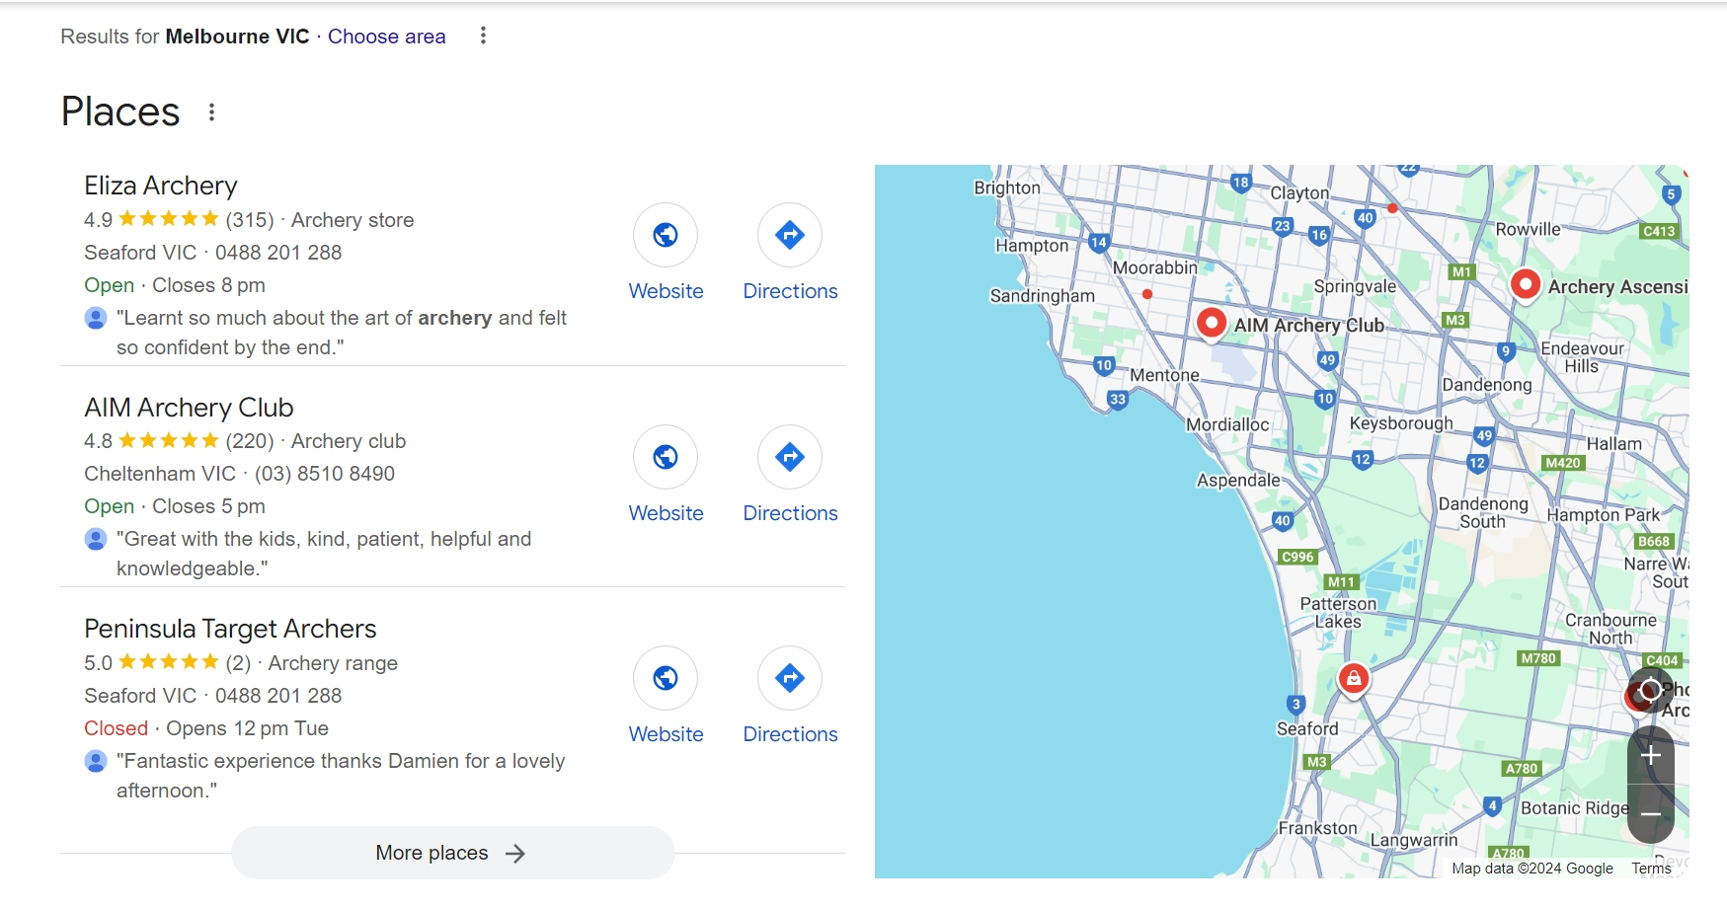
“Archery Lessons Near Me” Keyword Search Results

Slide 5
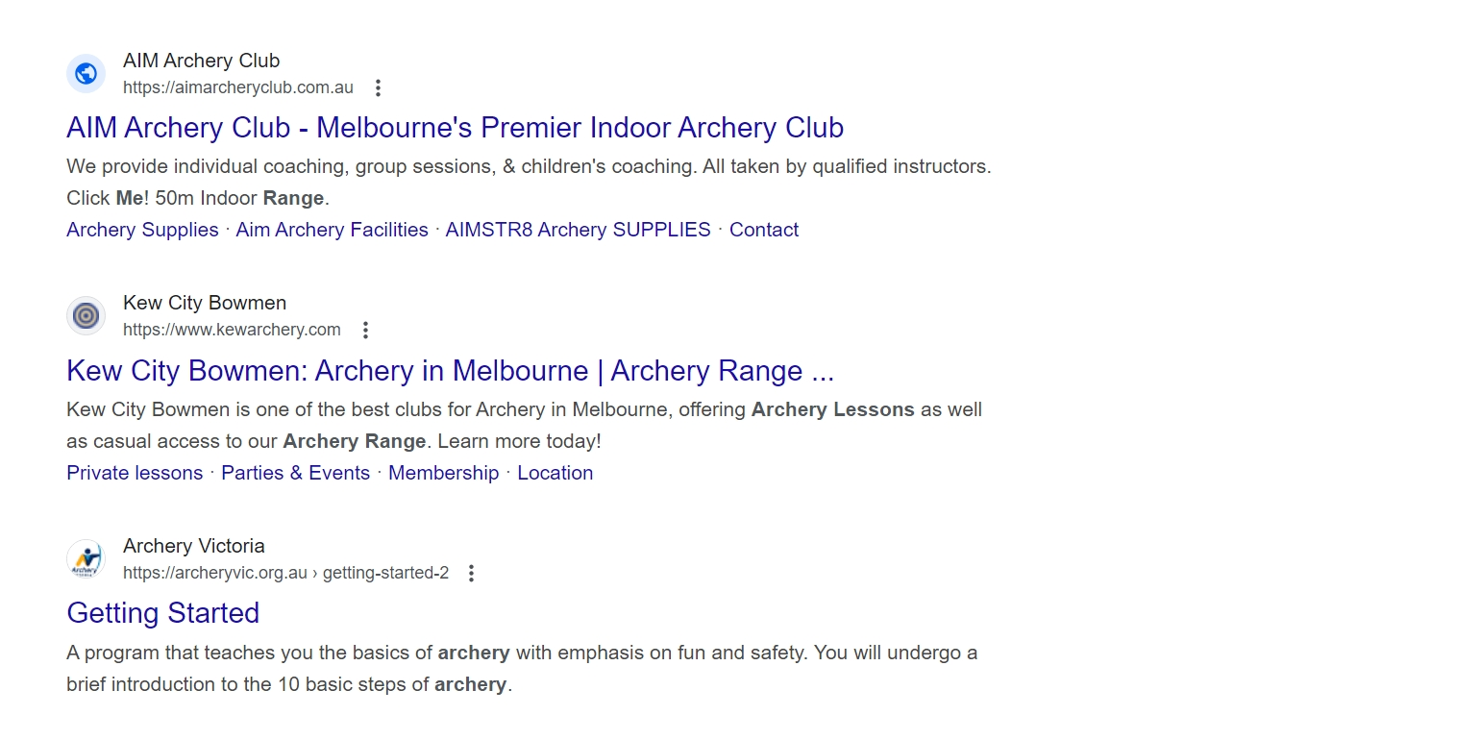
Archery Victoria Link Appears 3rd link down below maps

Slide 6
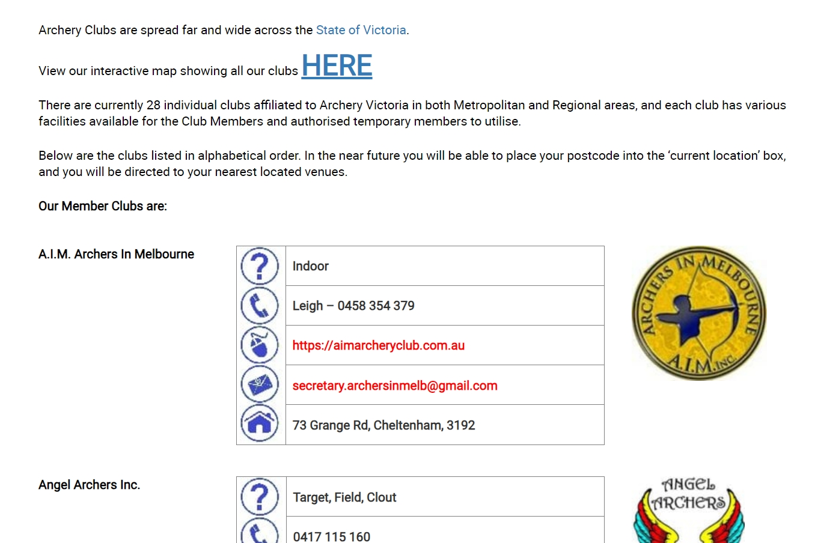
List of clubs including interactive map

Slide 7
This is where it gets difficult for a new archer
Victoria has 28 Clubs
Of those 28 clubs, 2 don’t have active websites
10 clubs (35%) currently have online bookings available, most use the trybooking software or tidyhq
3 website links didn’t work and 6 had a facebook page instead of a website.
Finding contact details on most of these websites proves very difficult, with many e-mail links old or broken.

Slide 8
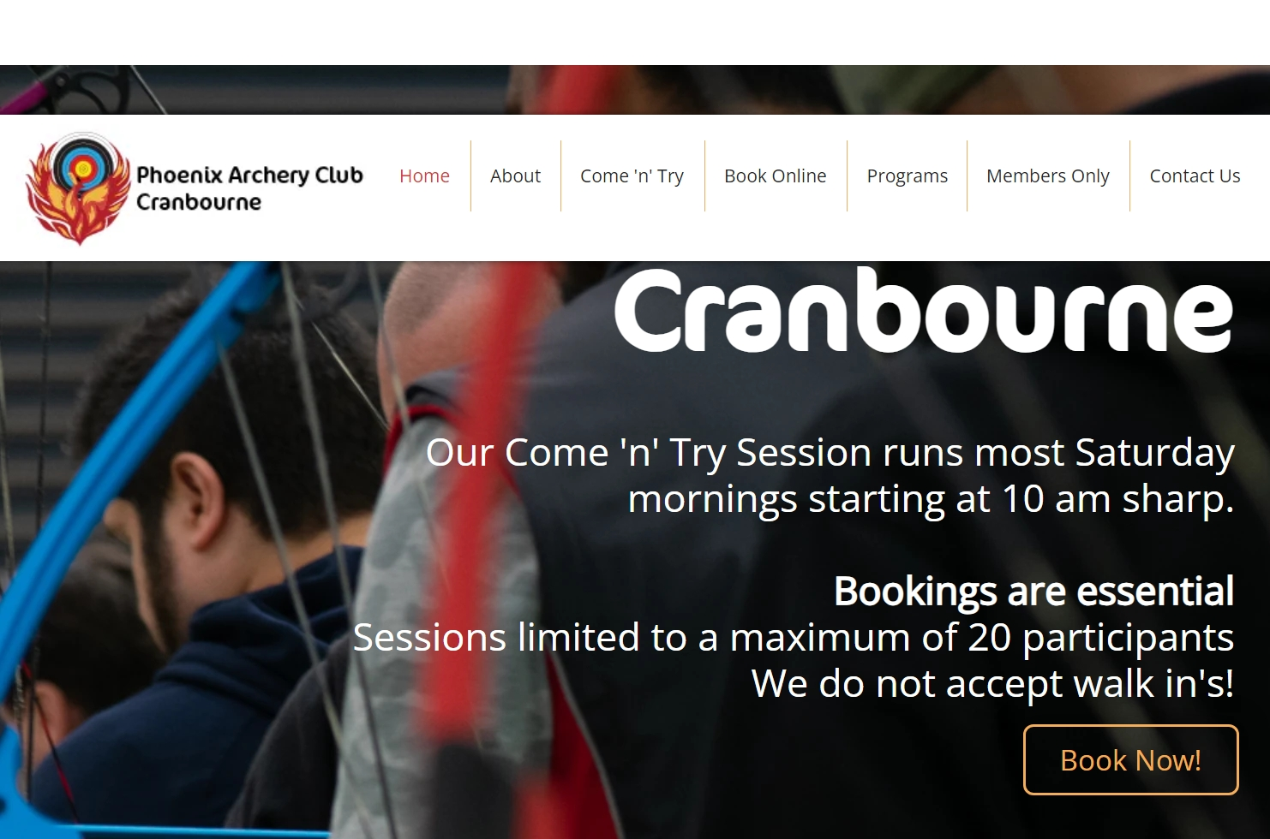
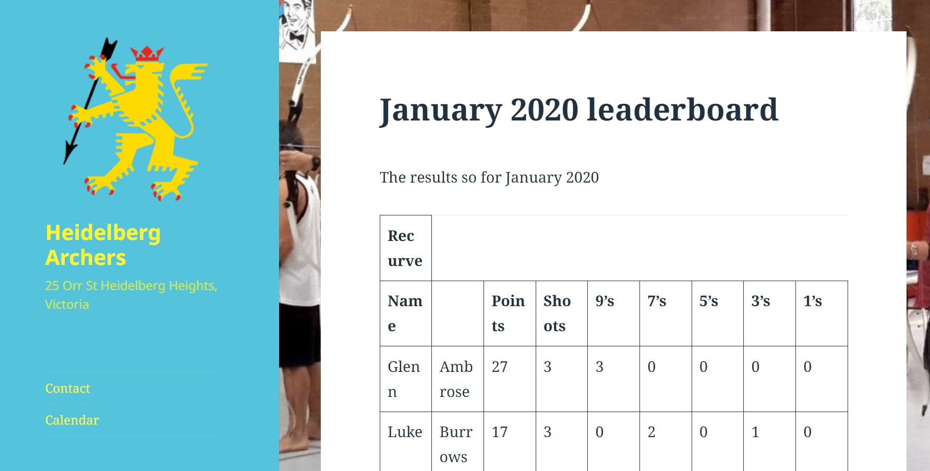
Difficulty in finding the booking link
An example of an easy to navigate website for a new archer
An example of a poor website for a new archer

Slide 9
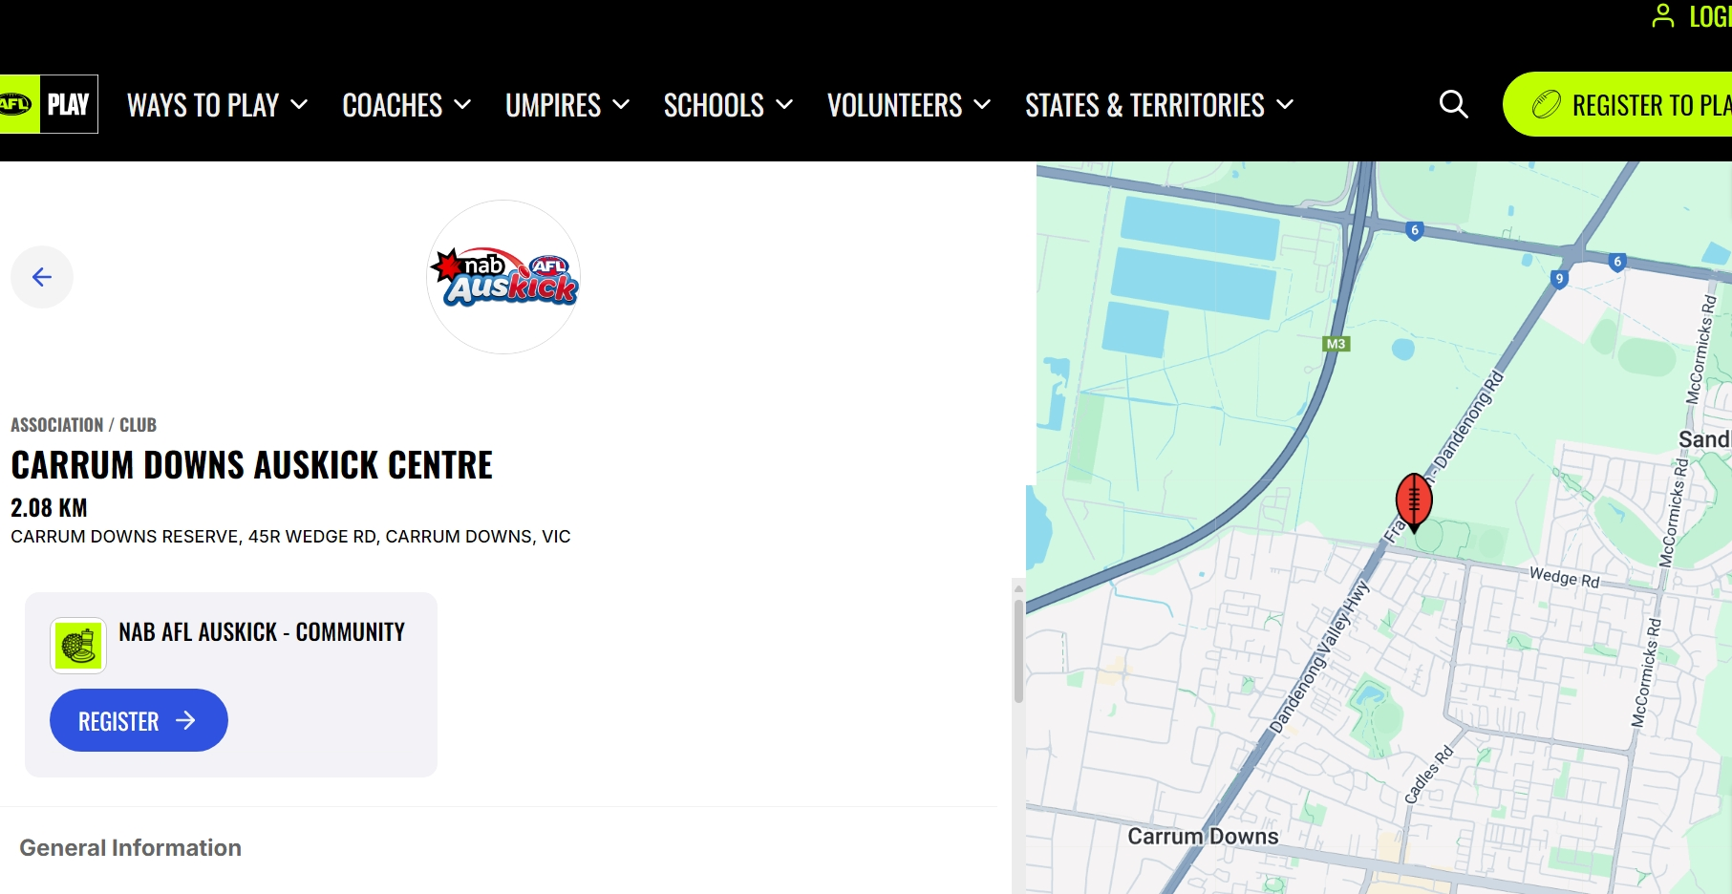
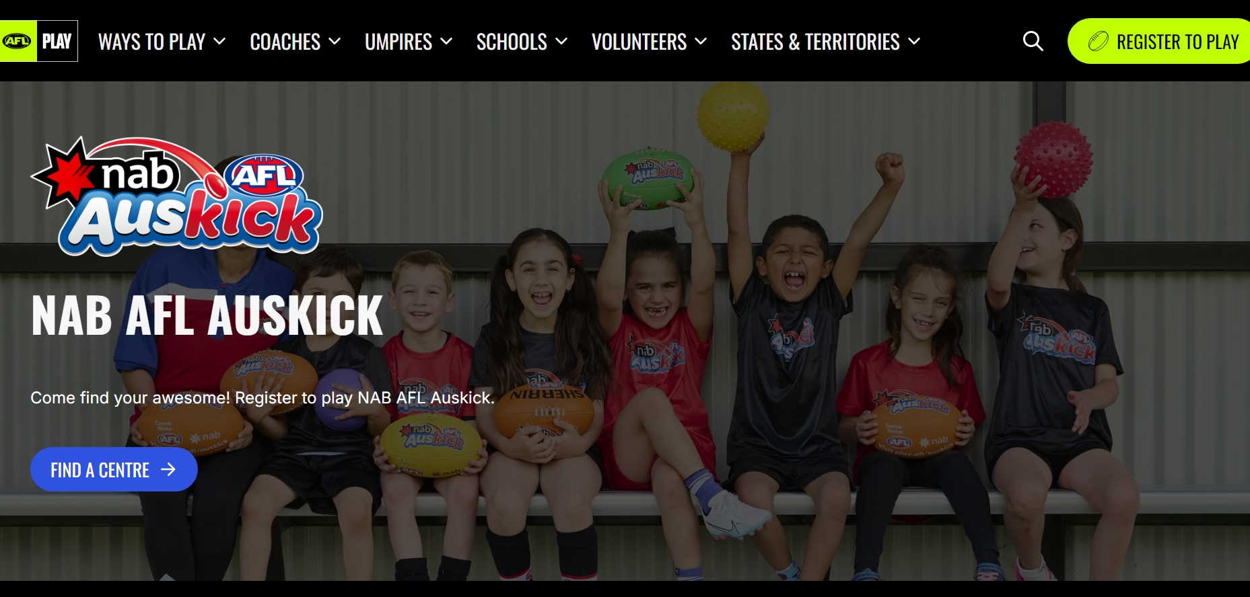
Process of Auskick Sign-up

Slide 10
Online Booking Statistics
More than half of Millennials and Gen Xers say they would switch providers for the ability to book appointments online.
41% of all booking services are found through social media. (36% of these bookings come through Instagram, while 22% come through Facebook. Social media is one of the first places people look to schedule appointments)
82% of clients use mobile devices to book appointments.
94% of individuals would be more likely to choose a new service provider if that provider offered online booking options.
Rob Kaufhold (owner of Lancaster Archery, the biggest shop in the world and hosts many successful archery programs). When asked what was the biggest piece of advice he could give to an archery business or organization, his reply was to ensure that they had an easy to use online booking system
Source; https://www.zippia.com/advice/appointment-scheduling-statistics/

Slide 11
Positives of an online booking system
Lots of time saved from an administration perspective having to reply to e-mails, compile a list of attendees, keep a record of details etc.
All the participants details are stored online and easily contactable for future sessions, reminders of club days etc.
Ability to easily contact all registered participants if the session time has to change due to weather, sickness etc.
Easier to reconcile payments as they are all done through the portal
At present we have 96 Level 1 Coaches in Victoria (and 52 more across level 2/3 coaches), which means we should have close to 3 per club to manage the extra demand, with more courses currently scheduled. https://archeryvic.org.au/coaching/

Slide 12
Negatives of an online booking system
It is a change from what the majority of clubs are used to
Could take some time for clubs to learn how to utilize the software
Increased demand will mean some clubs will need to increase the amount of coaches who are ready and available within the club
Software may have to be paid for

Slide 13
Social Media Presence Of Clubs
26 clubs in Victoria have Facebook (92%)
13 clubs in Victoria have Instagram (46%)
32% of Instagram users are in the 18-24 age bracket, whereas 35.6% of Facebook users are in the 25-34 age bracket.
Given the decline in Youth memberships in Victoria, an increased Instagram presence for our clubs could assist this.
Source; https://www.statista.com/statistics/325587/instagram-global-age-group/

Slide 14
How do we handle the extra demand?
Increase the availability of instructors to host these sessions by suggesting that clubs provide payment to their instructors, this can also be a great opportunity for development for junior members.
We can also look outside the sport and advertise that the course cost could be covered by AV or the club to encourage new instructors that don’t have to be archers.
Using the online portal to easily manage and see in advance how many attendees are expected at each session, so that members are not turning up unnecessarily.
Creation of an easy system that all clubs can use to provide payment to their instructors for conducting these sessions.

Slide 15
Retention – What happens after a “Try Archery” session
The most common feedback I’ve heard from archers completing these courses is the large financial/time commitment to join a club. The next step shouldn’t be $300 membership and buy a bow. We need steps in between this.
We also need to recognize there are many archers “outside” of Archery Australia/AV that already own equipment and shoot recreationally. These are the easiest to convert, so we need to think about what the membership process looks like to them and remove any barriers in place such as paying outright for membership or having to qualify to shoot distances they are already shooting etc.

Slide 16
Proposed Pathway – Step 1
“Try Archery” session
An individual can easily search for “Archery Lessons Near Me” or similar, find the “AusArchery” portal which will automatically use their location to recommend their nearest clubs.
They can see when the next availability is for these sessions and book in with their local club through the same website without having to call, e-mail or contact anyone.

Slide 17
Proposed Pathway – Step 2
At the completion of the “Try Archery” session, the club provides the archer with a leaflet highlighting details of the “Intro to Archery Course” on one side and the Membership details on the other.
They are also automatically sent a 10% discount via the booking system if they book into either of these programs within 7 days of completing their Try Archery session.

Slide 18
Proposed Pathway Step 3
After completion of the intro course, a leaflet will be given and a discount automatically sent for 10% off the membership cost of the club which they have completed their sessions at, it will also be time based and expire within 7 days.
They will also have the option to pay for this membership via direct debit (of which the discount will not be applied)
They will then be given the details of the Ozbow program, so that they have clear goal to work towards each time they attend the range. During this time they can opt to hire equipment from the club.

Slide 19
Proposed Pathway – Step 4
Now these individuals have been successfully converted into members (hopefully with their own equipment by now). The final piece of the puzzle is to provide a place through the portal where they can receive support if they need help with their technique, equipment etc. where they don’t have to rely on the volunteer structure.
I’d like to copy the golf model, where every golf course has a dedicated number of “Pro’s”. These could be level 2 accredited coaches who charge a nominal fee for 30 or 60min sessions, where a percentage is given back to the club.
I’ve attached an example link below, not every club has to have level 2 coaches. But as long as nearby clubs have members available who can perform this, a new archer is able to easily access support and direction.
https://centenarypark.com.au/learn/

Slide 20
“Try Archery” Goals
There are 2 main goals in these sessions, the first of these is to get archers shooting within 5 minutes of the start time, after a simple and easy to understand introduction. The second is to always have the participants leave, feeling as though they are hooked and want to shoot more arrows.
It’s important to remember that the goal of these sessions is for archers to leave with a smile on their face, rather than perfect technique. As that can be learned later once they have found a passion for the sport.

Slide 21
Proposed “Try Archery” Format
1. Line up all new archers on the shooting line without a bow and explain the basics of technique and ask them to mimic this without the bow. Then explain the safety rules relevant to your club (max 2-3min). Starting the archers at 5-10m.
2. Spend 15min or so letting them figure out the technique while you walk up and down the line to assist them.
3. Explain how the scoring works and provide a score (e.g 15/30 per archer). That will enable them to move their target back one meter, if they do not achieve this score, they will need to move their target one meter closer to the shooting line. So if there are 3 archers on a target, the target needs to achieve 3*15, so 45 in total for them to move back.
4. Check in on them throughout the session offering advice if needed (very very simple technique advice) and anecdotes of your own experiences in archery. Then finish with some balloons on the targets for the last 10 minutes.
5. Ensure that you debrief participants at the end and clearly explain the next steps, to get involved in your club.

Slide 22
Recommendations
Move to an “AusArchery” online system where clubs can register and set-up a portal for their sessions, similar to the Auskick website
Contact accountant to help organize an easy system for clubs to compensate their members for their time in hosting the sessions (query super etc.)
Creation of a paid Facebook/Instagram marketing campaign of the new “Ozbow” booking portal. Funded by AA to promote clubs.
Time-Based discounts to be automated through the online system after completion of the courses for membership, intro course etc.
Clubs to be encouraged to create a Facebook and especially Instagram social media presence.
Create the option for new members to pay their membership via direct debit, such as Ezidebit.

Slide 23
How do we maintain retention after these steps?
Ozbow and Beginners Courses some clubs already have in place
Easy access to Coaching, like Golf or Tennis
Club Shoots/Club Days
Encouragement from members to be involved in QRE’s/Competitions

Slide 24
Recommended Actions
Check your website link works from the AV Club Finder
Get a friend or family member to “google” your club and see how easy it is for them to navigate and book a try archery session
Have a look at creating and Instagram account and linking it with the existing Facebook page.
Have a think about the steps your club has between the first try session and then the big financial/time commitment of purchasing gear and becoming a member.

